Slide 1

Group 1: Case Study #1 Predicting Flight Delays using Multiple Linear Regression
Brianna L. Palmisano, Julianna LoMonte & Ava C. Rice
St. John’s University, The Peter J. Tobin College of Business
Seminar in Business Analytics, Business Analytics & Information Systems Department
Professor Michael D. Herley, D.B.A.
Fall 2024

Slide 2
Introduction
This evaluation uses global airline industry data to examine the linear relationship between operational factors, with the goal of identifying key explanatory variables that influence flight delays.
Information regarding global flight delays could not only be valuable for analyzing both the internal and external factors that go into our understanding of predicting delayed flight arrivals, but for making data-driven decisions on how to prevent and adapt to compromises to flight scheduling and other operations contributing to airline success.
As a vital part of economic growth, the airline industry is a growing sector that requires innovating predictive models to accurately and productively make data changes with the global economy. This data has been analyzed using graphical techniques, descriptive statistics , as well as correlation and regression statistical analysis, via R-Script.
Notes:
B

Slide 3

Overview of the Airline Industry
The airline industry plays a crucial role in enabling global transportation for both passengers and freight.
As of 2018, the global net profit of the airline industry was forecasted to be $38.4 billion, with approximately 3.8 billion passengers flown annually, by end of year.
By 2035, the number of passengers is expected to reach 7.2 billion, a rapid growth in global importance of the industry (according International Air Transport Association (IATA)).
Airline companies are classified by the United States Department of Transportation (DOT), via air carrier revenue groupings 3 – 1; above 1 billion, between 1 billion and 100 million, and below 100 million, dollars.
Major players in this industry include carriers American Airlines, Delta, and United Airlines, all United States companies.
Notes:
B

Slide 4
Previous Research; Current Applications of Analytics
Predictive analytics plays a critical role in uncovering hidden patterns in massive data sets generated by airlines, such as customer bookings, flight operations, and maintenance records. All airlines are making efforts towards remaining competitive within their markets as the demand for air transportation continues to rise.
Key Challenges
Safer Flights:
Personalized Offers & Passenger Experience
Fraud Detection
Sustainability
Level 1, Level 2, Level 3, Level 3+

Slide 5
Why Predicting Flight Delays?
The main challenge that all airlines experience is delays in flight arrival. Flight delays are detrimental to an airline's reputation and reliability. Since there are many variables that can cause a delay in a flight's arrival, it is important to measure which variables directly cause a flight's delay.
Business Problem: Flight delays cost airlines millions of dollars and lead to customer dissatisfaction. Preventing flight delay decreases the airlines operational costs, while contributing to the reputation and reliability of the airlines brand.
Objective: Build a predictive model to anticipate flight delays using multiple linear regression. Predictive models help to identify trends in variables that could be contributing to increased flight delays, allowing the us to be more proactive in our adjustments to things like plans and flight schedules.
Goal: Identify the key variables that significantly impact flight delays and help optimize flight scheduling. By tackling an airline's biggest challenge, preventing flight delays could help improve the airline travel experience, as a whole.

Slide 6

Data Overview
This is secondary, cross-section data of the global Airline Industry. The dataset includes 3,593 observations from 14 unique airline carriers. All observations have been taken within the same period. The 11 variables used in this model can be considered contributors to industry success, as well as economic indicators in some context.
The dependent variable here is Flight Arrival Delay, and the independent variables are the Airport Distance, Number of Flights, Weather, Support Crew Available, Baggage Loading Time, Late Arrival, Cleaning Time, Fueling Time, Security Time.
The data has been indexed by Carrier abbreviation, the only categorical variable among the numeric dependent and independent variables.

Slide 7
Descriptions of Variables
Variable Flight Arrival Delay Airport Distance Number of Flights Weather Support Crew Available Baggage Loading Time Late Arrival Cleaning Time Fueling Time Security Time Carrier | R-Script Arr_Delay Airport_Distance Number_of_flights Weather Support_Crew_Available Baggage_loading_time Late_Arrival_o Cleaning_o Fueling_o Security_o Carrier | Description Arrival Delay in minutes (target variable) Distance between the departure and arrival airports Total number of flights handled at the airport Weather conditions during flight operations Availability of support crew for flight operations Time taken for baggage loading (in minutes) Late arrival of the previous flight using the same aircraft Time taken for cleaning the aircraft (in minutes) Time taken for fueling the aircraft (in minutes) Time required for security checks Carrier (categorical, not used in the model)

Slide 8

Data Cleaning
Cleaning...
No missing values found
Carrier was dropped because its categorical, used as an index originally.
Outliers

Slide 9
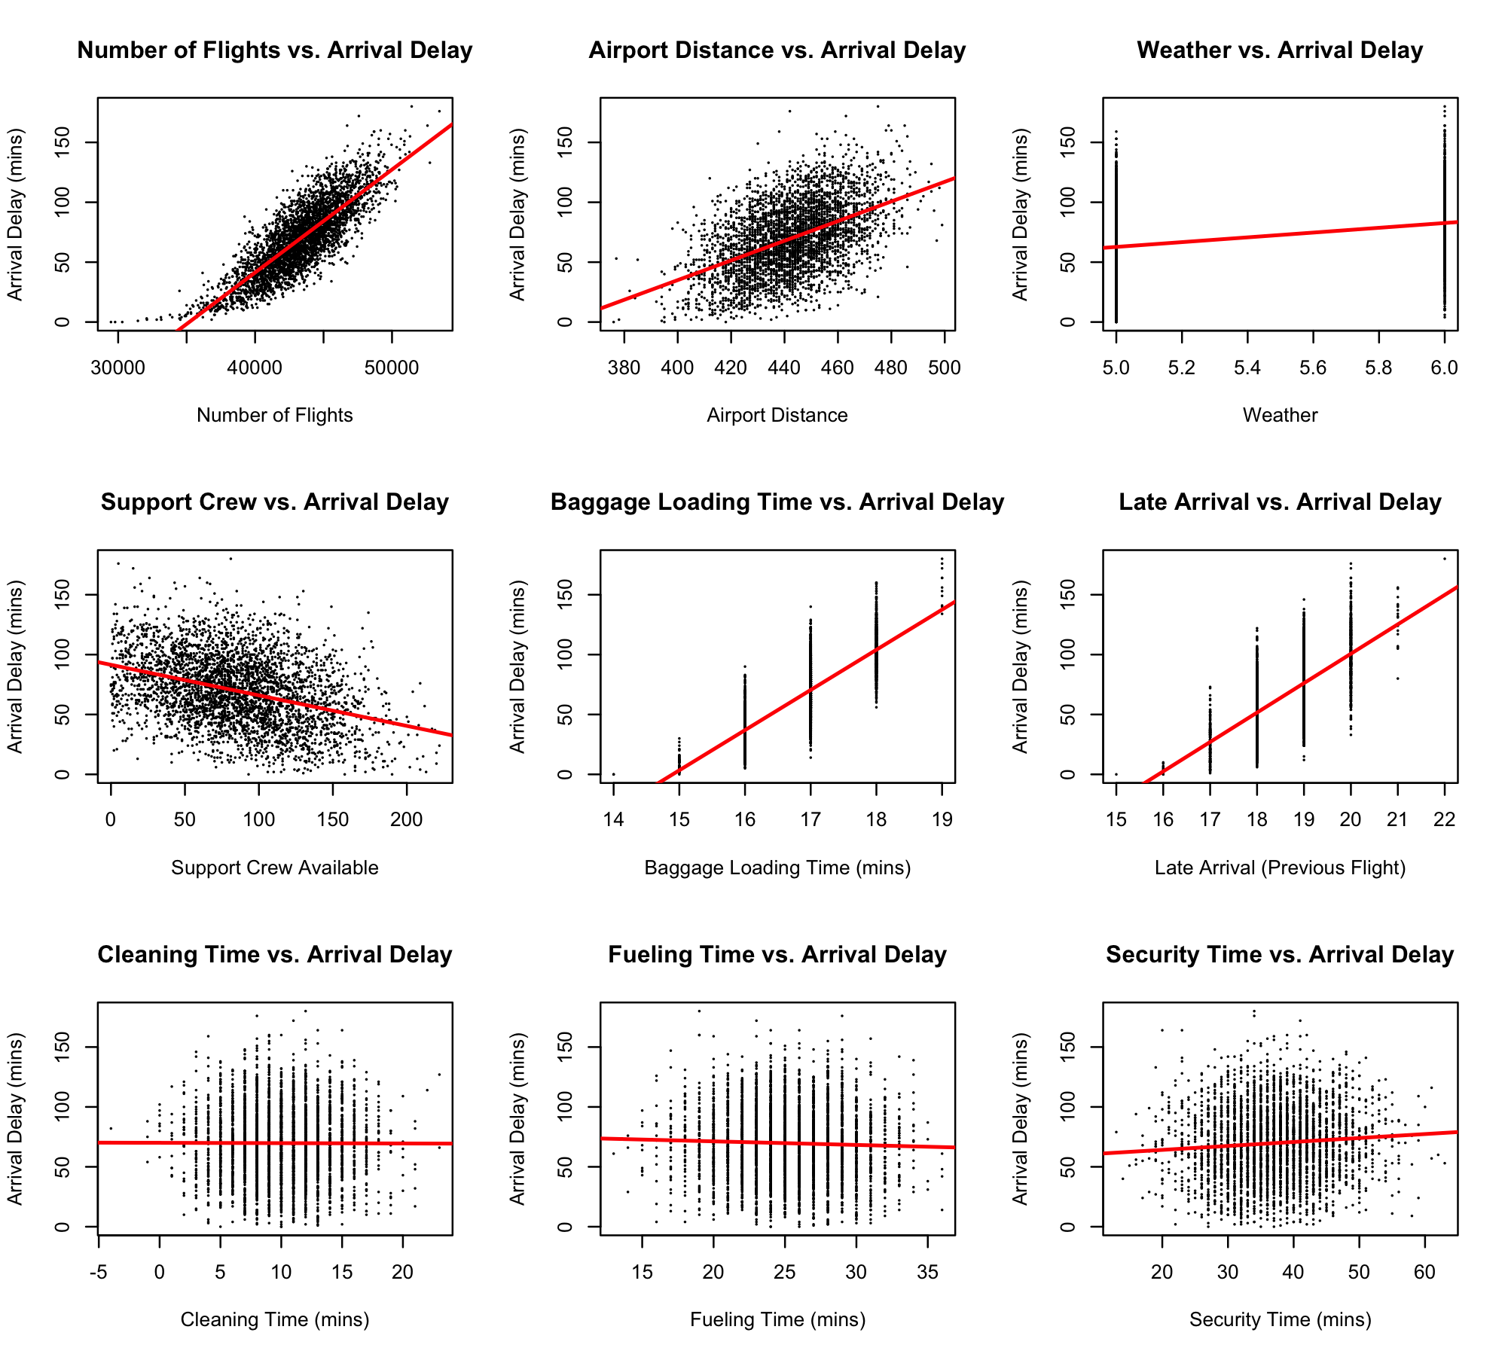
Exploratory Data Analysis 1
Graphical Analysis
Scatterplots were run for each independent variable relative to our target variable, Arrival Delay.
The plots for variables Number of flights, Airport distance, Weather, number of Support crew, Baggage loading time, and Late arrivals show a strong linear relationship with Arrival Delay.
The last three variables may show some linearity, but these relationships lack a clear positive or negative trend.
We can assume that flight delays hold the strongest positive relationship with the Number of flights, and the strongest negative relationship with the number of Support crew.

Slide 10
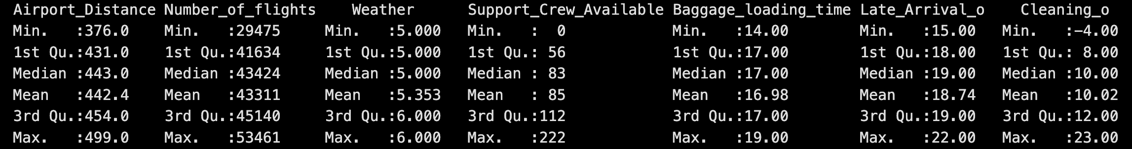
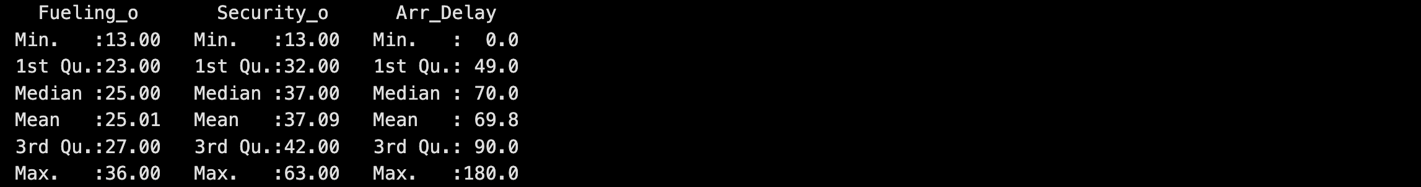
Exploratory Data Analysis 2
Descriptive Statistics
Mean arrival delay is 69.8 minutes, with some delays extending up to 180 minutes.

